Slide 1
The Evangelical Covenant Church of Rwanda (ECCR)
The Evangelical Covenant Church of Rwanda (ECCR), is an evangelical church operating in Rwanda, under the leadership of Bishop Apollinaire M. Gakombe, the ECCR Founder and Moderator. It was legally born on 09/03/2021, with legal status no129 / RGB / FBO / LP / 03/2021.
The ECCR Church has opened 13 different churches : In Kigali City (3 Churches), in Kamonyi District (4 Churches), in Gisagara District (4), in Huye District (1 Church), In Karongi District (1).
The ECCR Church has 741 church members, Men:.102, Women:.296, Youth: 125, Boys: 39, Girls : 86, Children: 146, New Disciples baptized: 72
The "ECCR" Church is the branch of ECC with its world headquarters in the United States (Chicago-Illinois), established on 20/02/ 1885, started by immigrants from the European continent in Sweden.

Slide 2
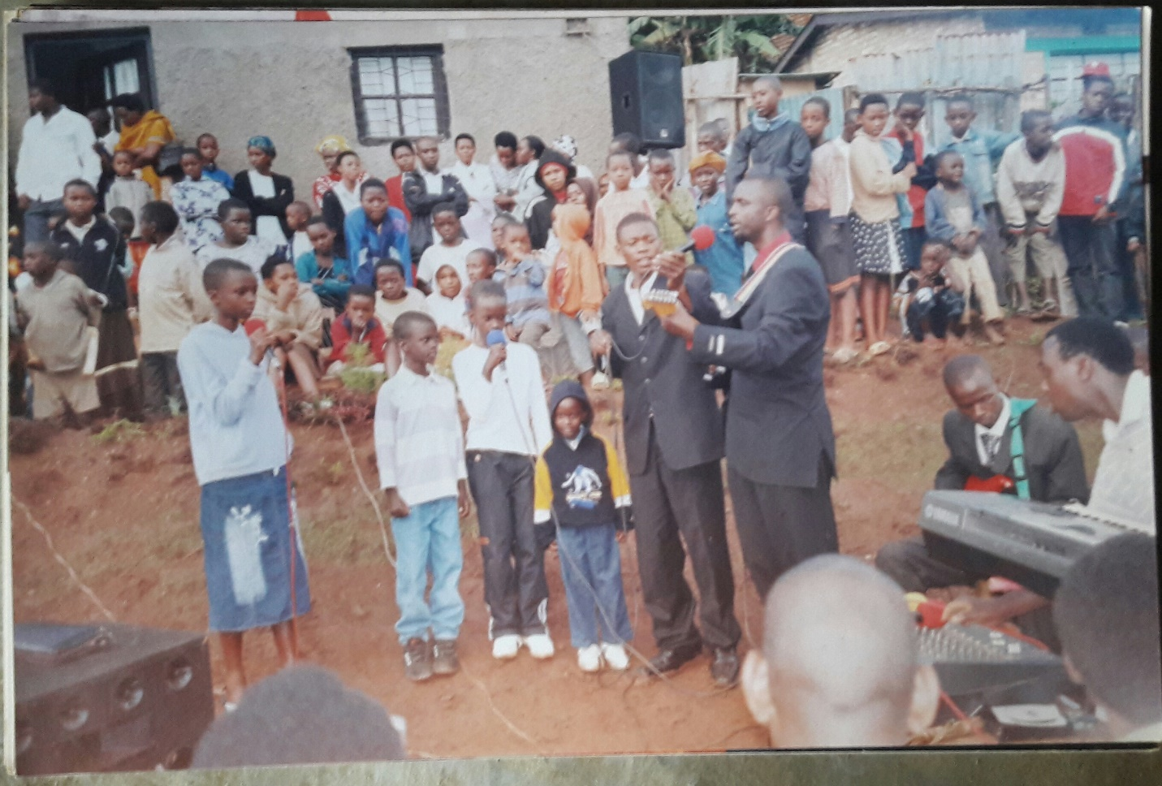
Historical Background of ECCR
The vision of the Bishop’s ministry with his family,this was the first crusade and started here,in the village Called Ngoma VI, Ngoma Cell, Ngoma Sector, Huye District ,Southern Province, in ADEPR where almost all of the Muslims live, in 2008.

Slide 3
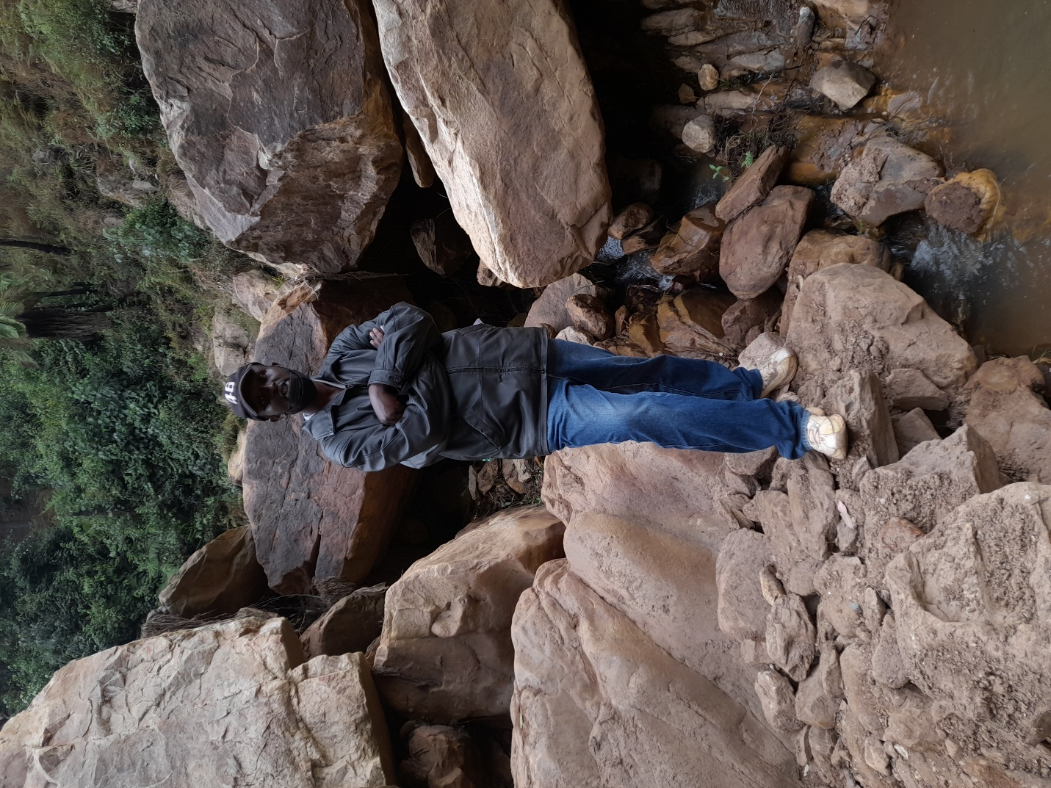
Historical Background of ECCR
Before starting the ECCR, the vision took time in prayer at Kanyarira Mountain Prayer.

Slide 4
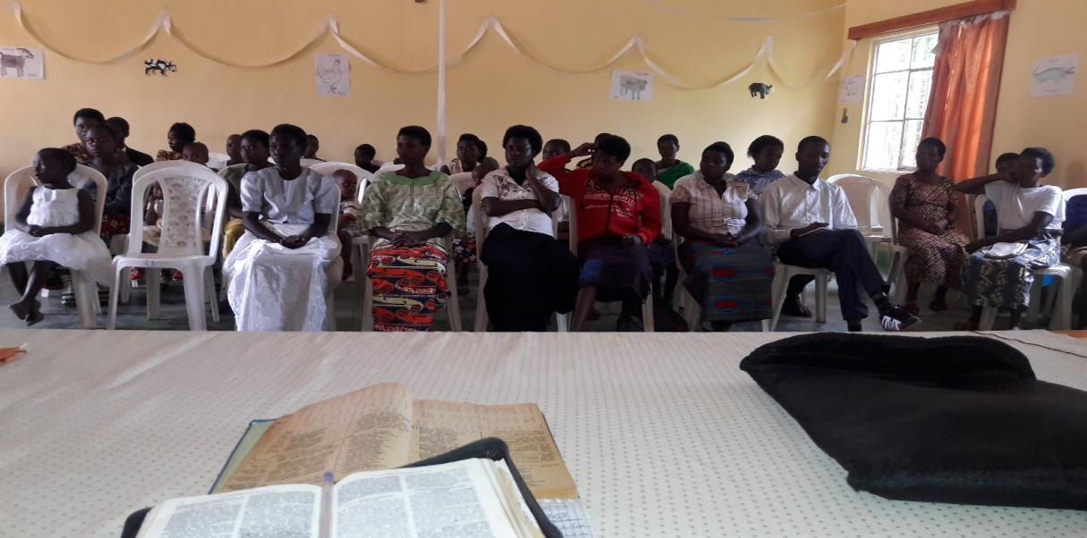
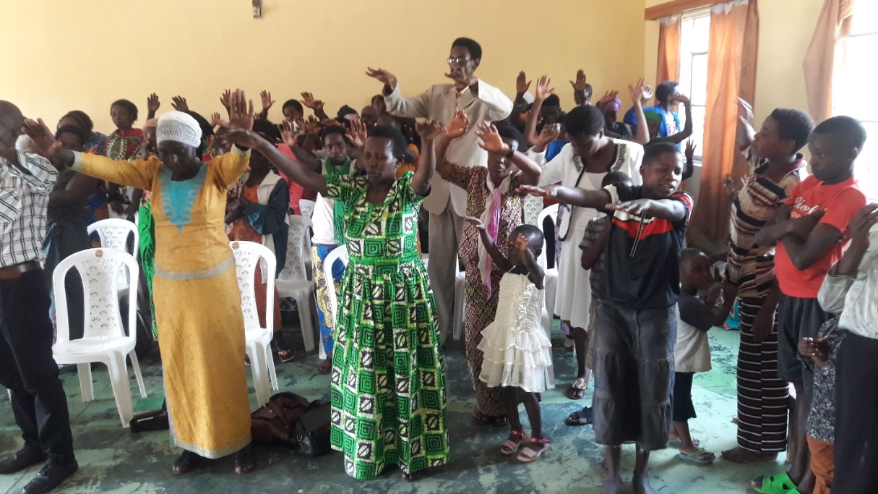
Historical Background of ECCR
The first church, however, was unable to continue
The first ECCR Branch in Muhanga District, Southern Province in Republic of Rwanda, in 2018,the first church,however,was unable to continue.

Slide 5
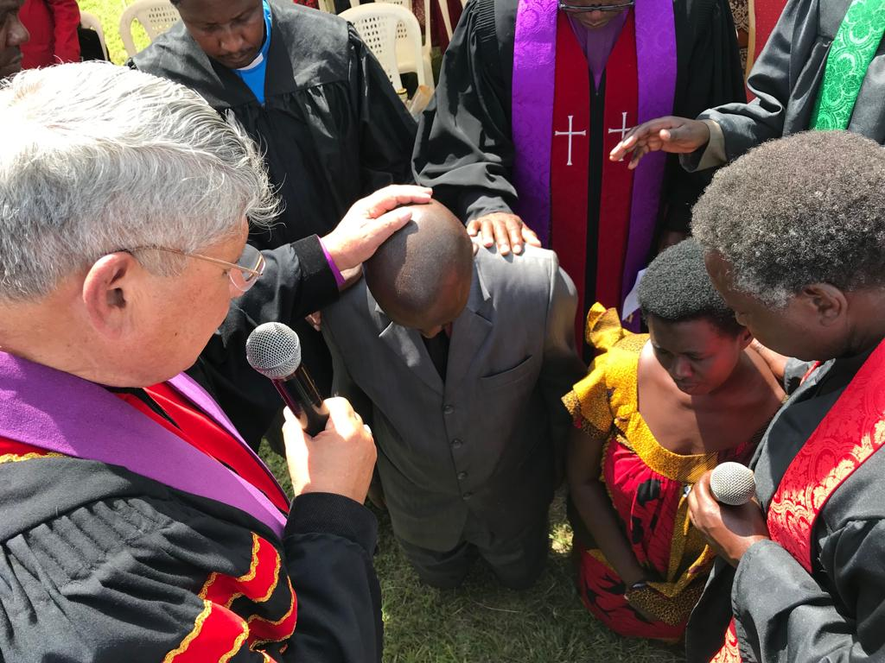
Historical Background of ECCR
The Consecration to the Pastor in Nakuru – Kenya,on 11th August 2019

Slide 6
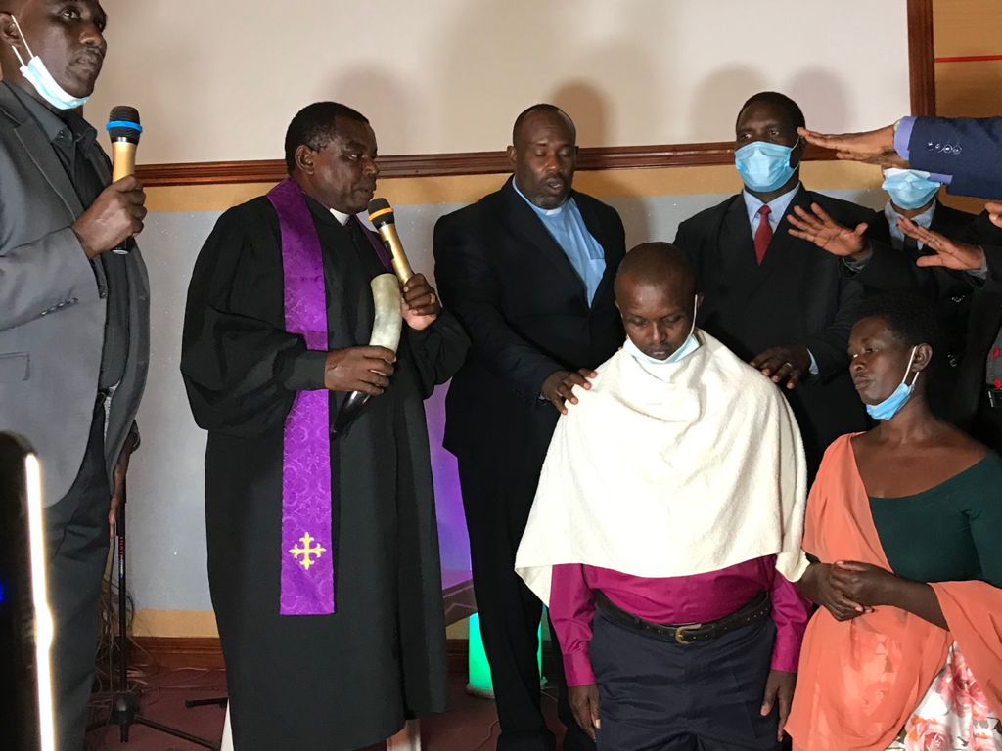
Historical Background of ECCR
The ordination Ceremony for the ECCR’ Bishop at Kimironko Sector – Gasabo District-Kigali City, on 29th August 2021

Slide 7
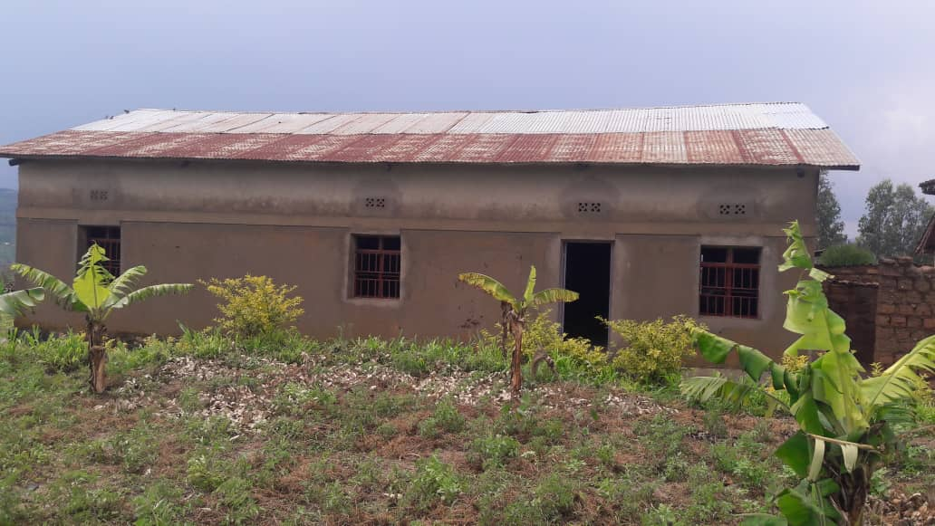
Historical Background of ECCR
ECCR Bunyonga Chapel/ Kirwa Parish/ Kamonyi District

Slide 8
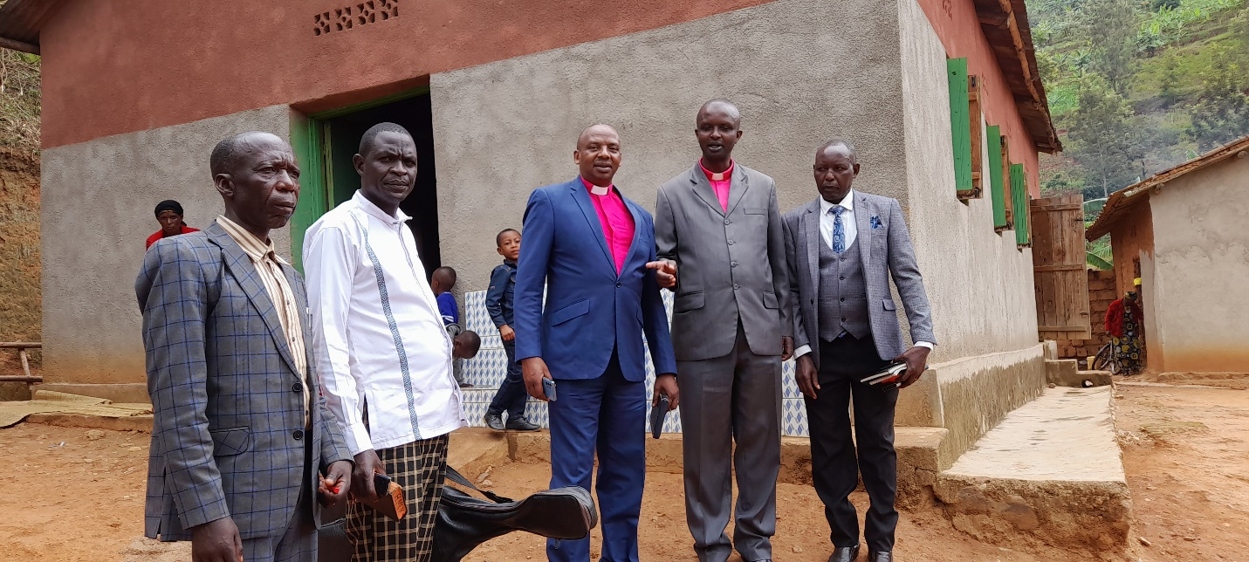
Historical Background of ECCR
ECCR Cubi Chapel/ Kirwa Parish/ Kamonyi District

Slide 9
Historical Background of ECCR
ECCR JurweParish in Kigali City (This is not Jurwe.it is repeted .

Slide 10
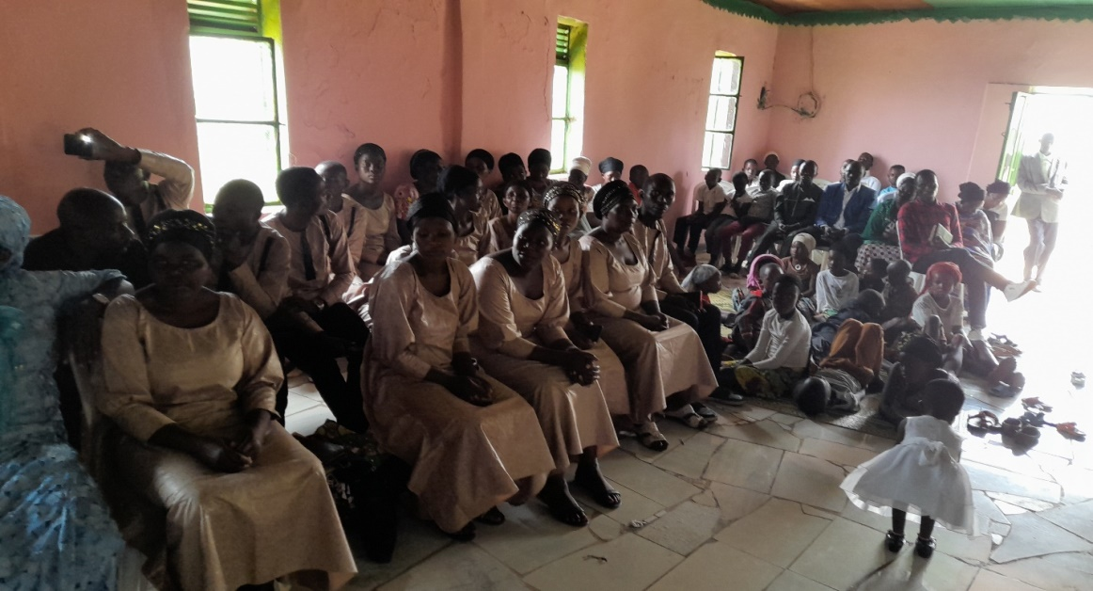
Historical Background of ECCR
ECCR JurweParish in Kigali City (This is not also Jurwe I Kigali but Cubi.kindly delete it.

Slide 11
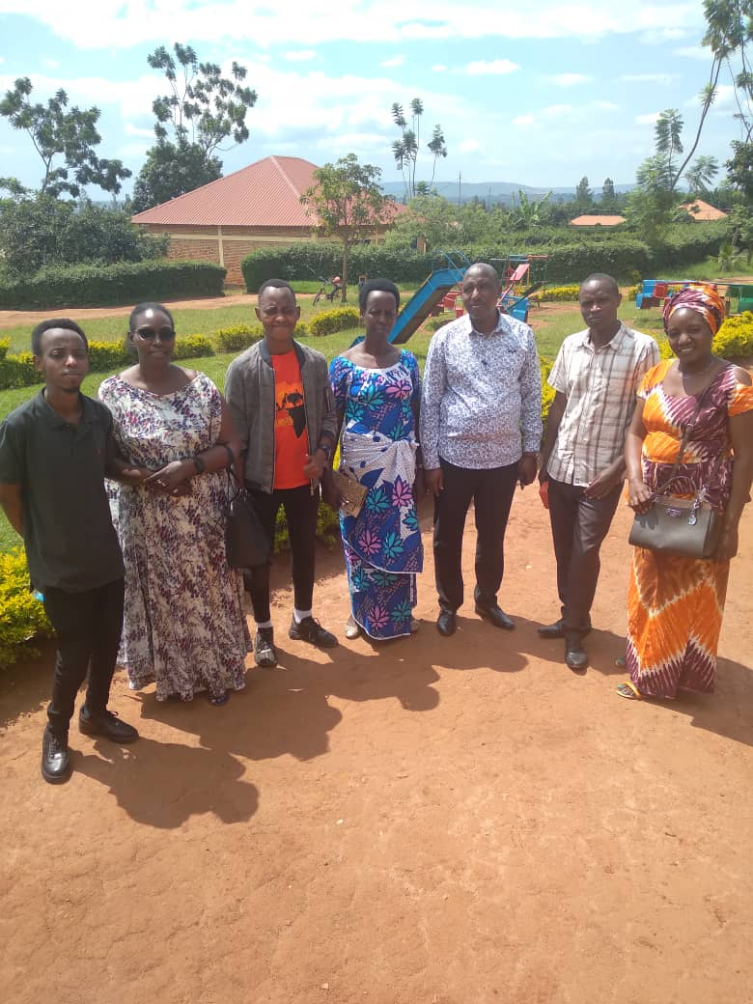
Historical Background of ECCR
ECCR Chapel / Masaka/ Kicukiro District on 27/03/2022

Slide 12
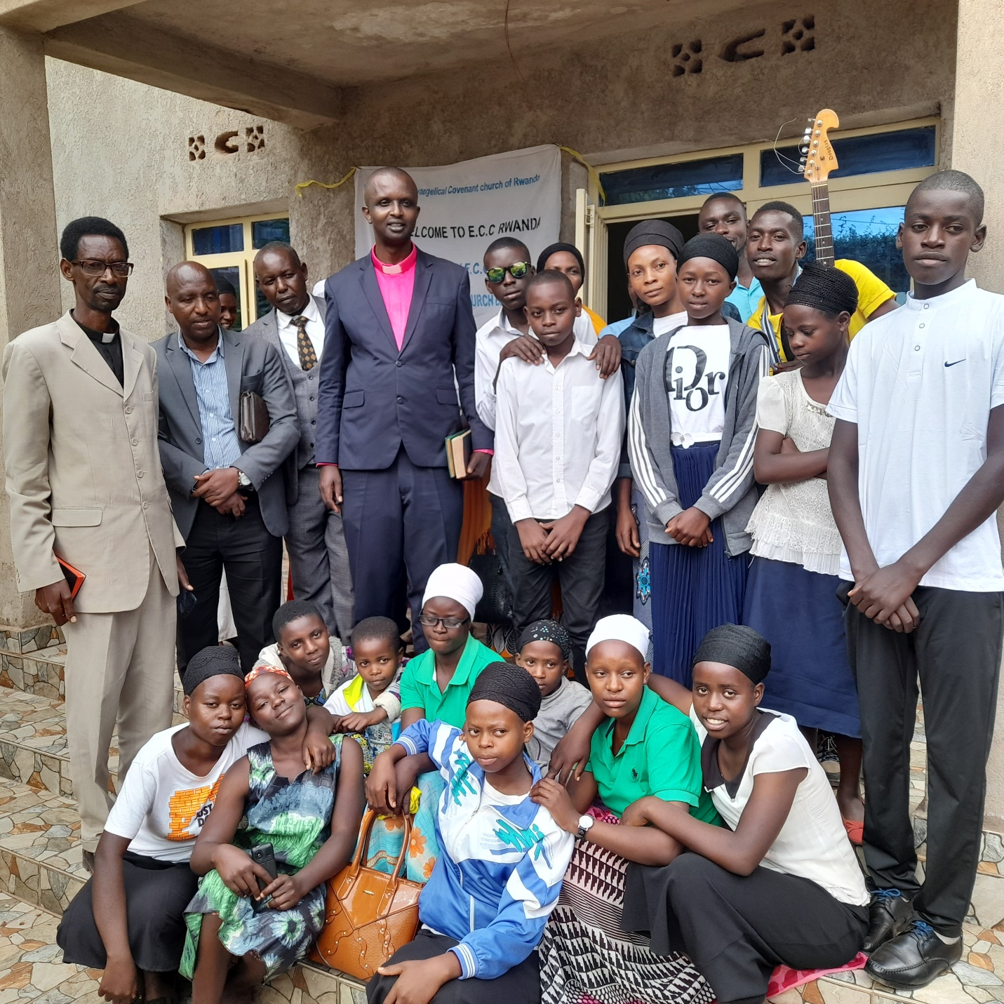
Historical Background of ECCR
ECCR JALI CHAPEL ON 29/01/2023

Slide 13
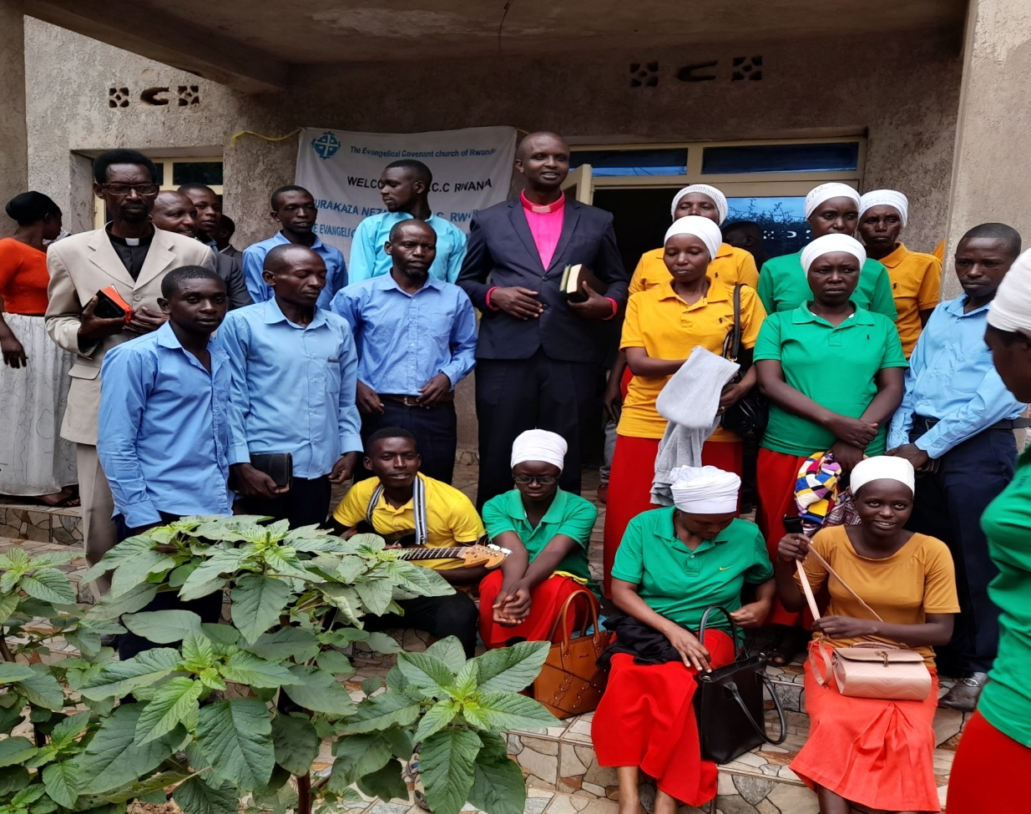
Historical Background of ECCR
ECCR JALI Sector.Gasabo District,Kigaly City CHAPEL ON 29/01/2023

Slide 14
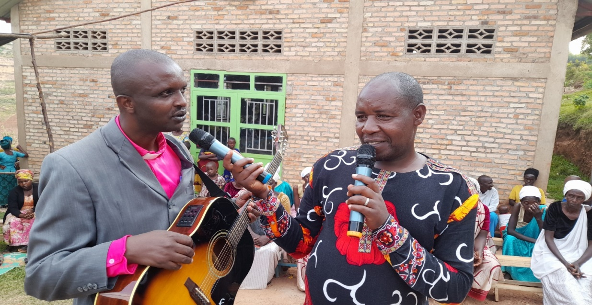
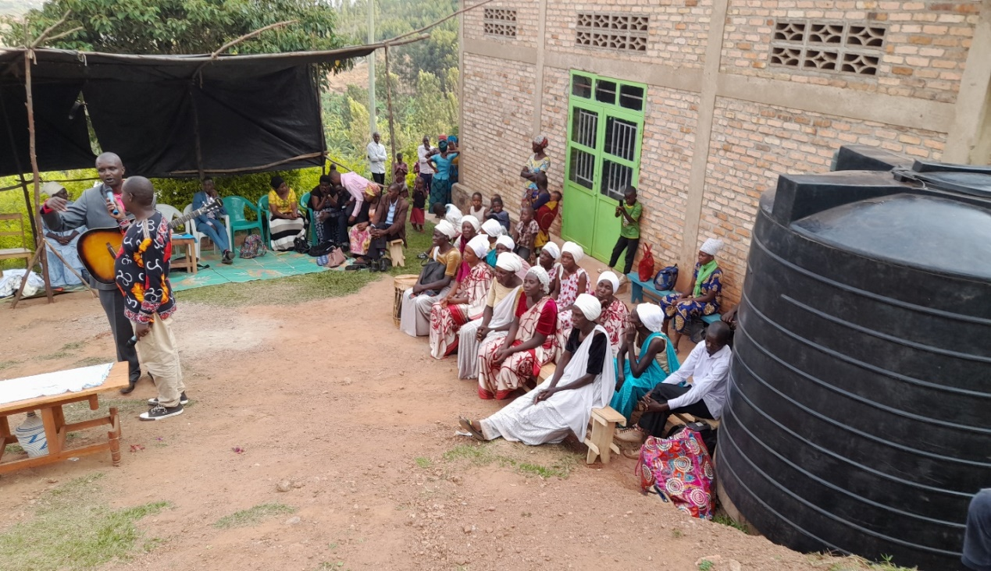
Historical Background of ECCR
ECCR MUSHA Sector,in GISAGARA DISTRICT,Southern Province

Slide 15
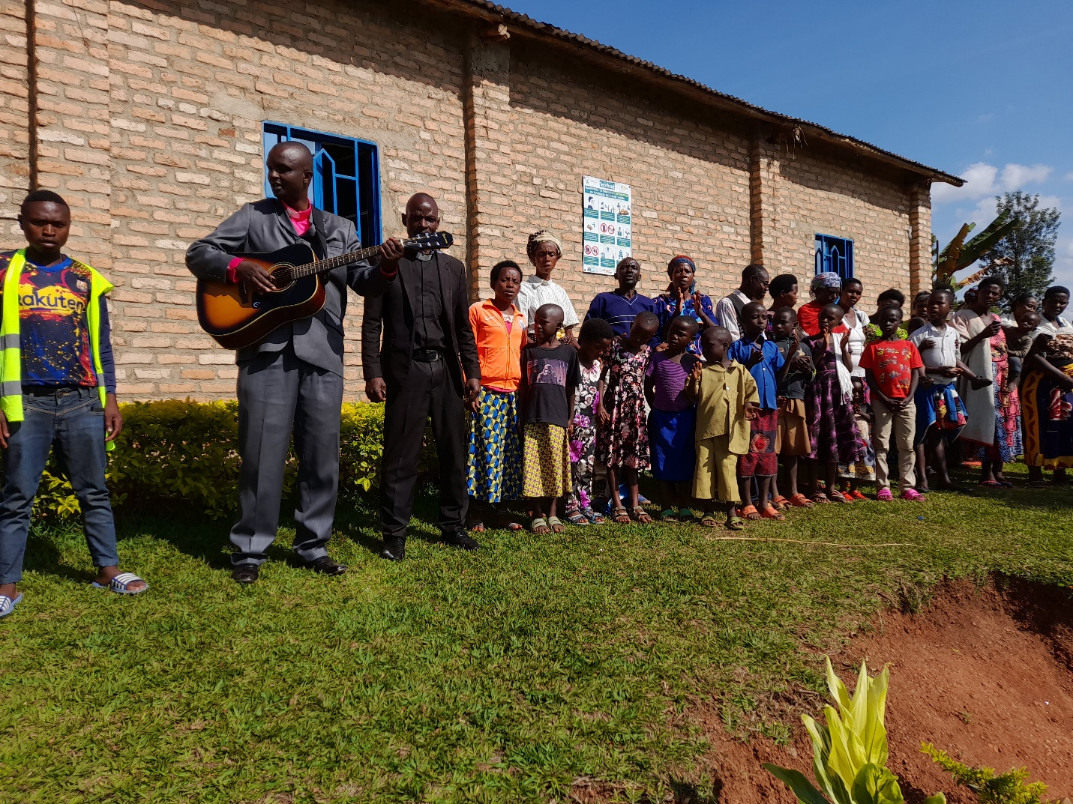
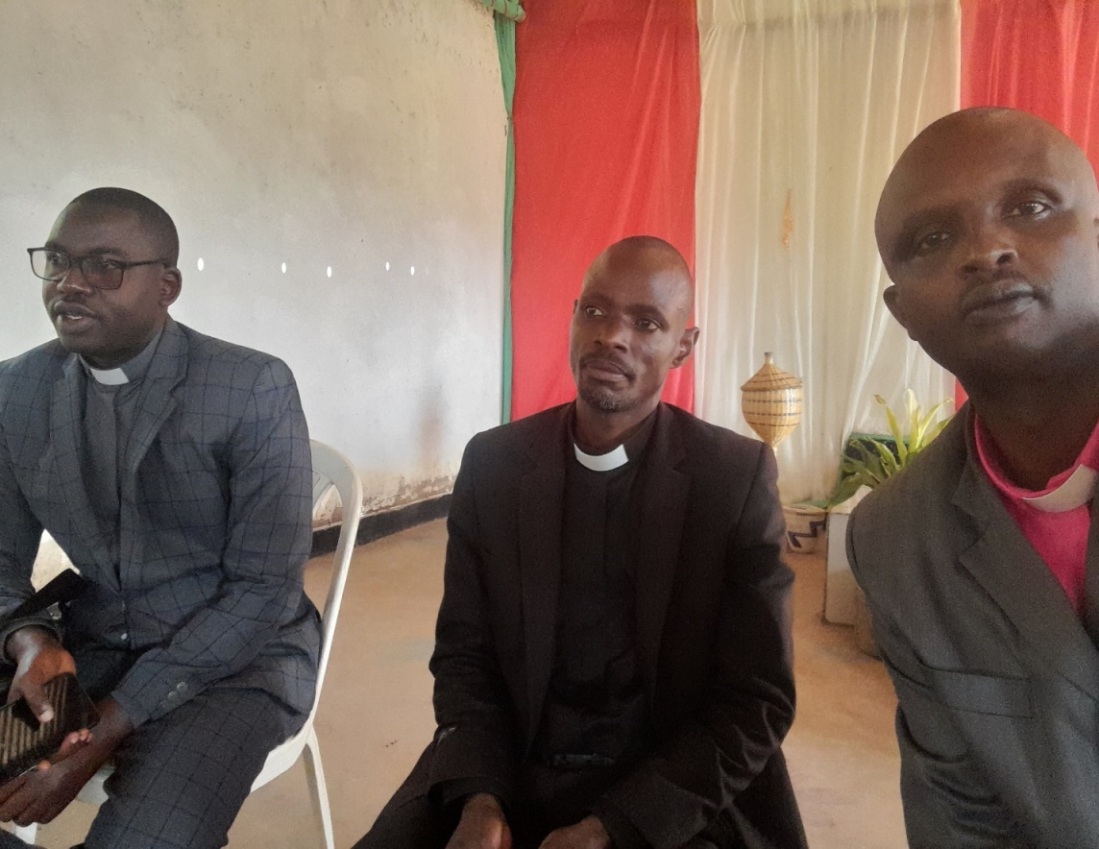
Historical Background of ECCR
ECCR Kibirizi Sector,in Gisagara District,Southern Provine.

Slide 16
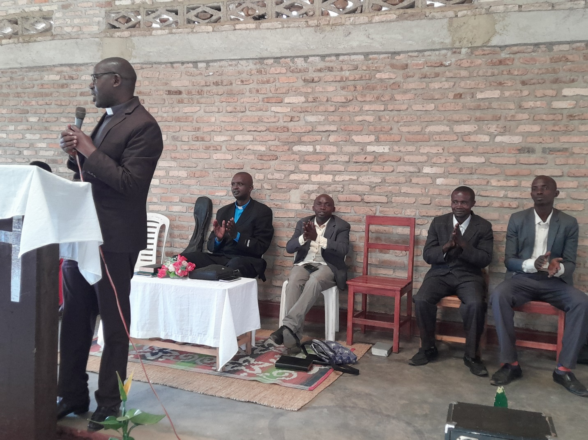
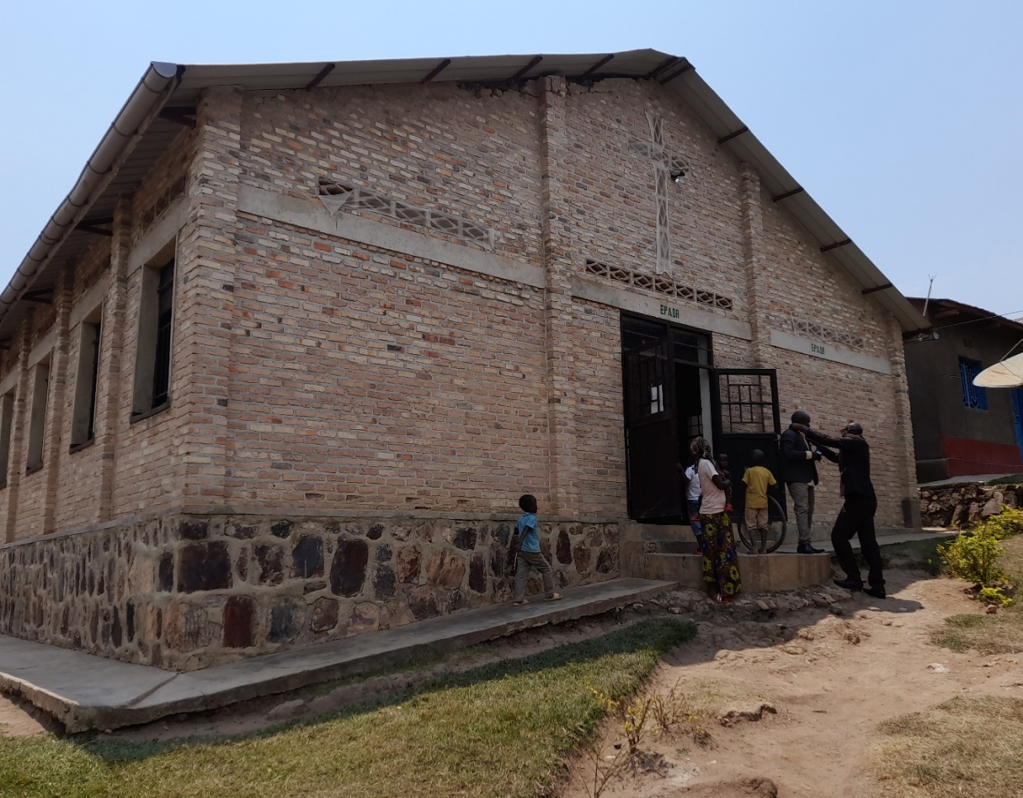
Historical Background of ECCR
ECCR Nyaruteja Cell,Nyanza Sector, in Gisagara District,Southern Province.

Slide 17
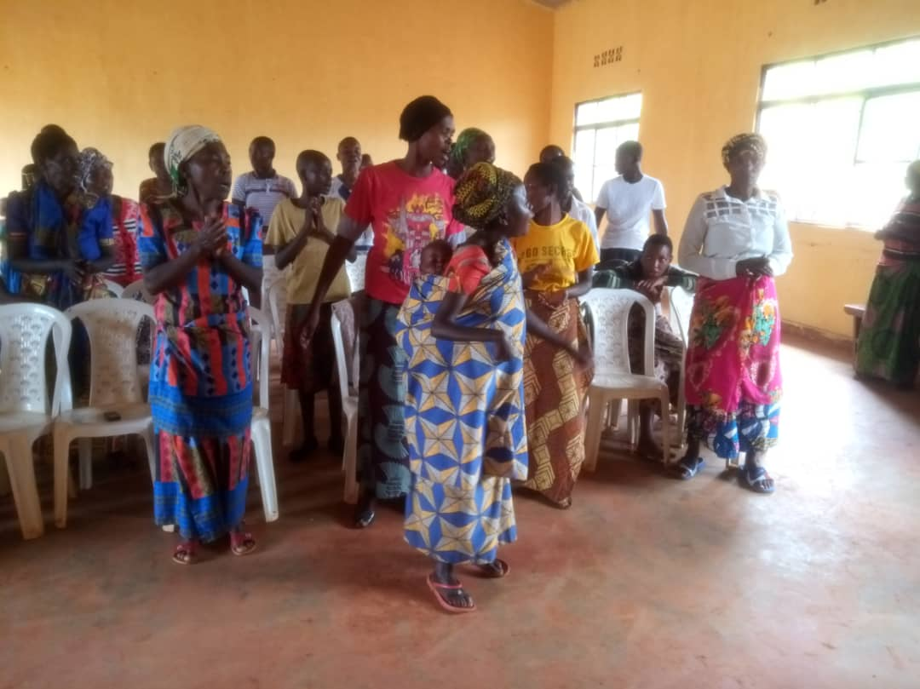
Historical Background of ECCR
ECCR KIGOMA Sector,in HUYE District, Southern Province.

Slide 18
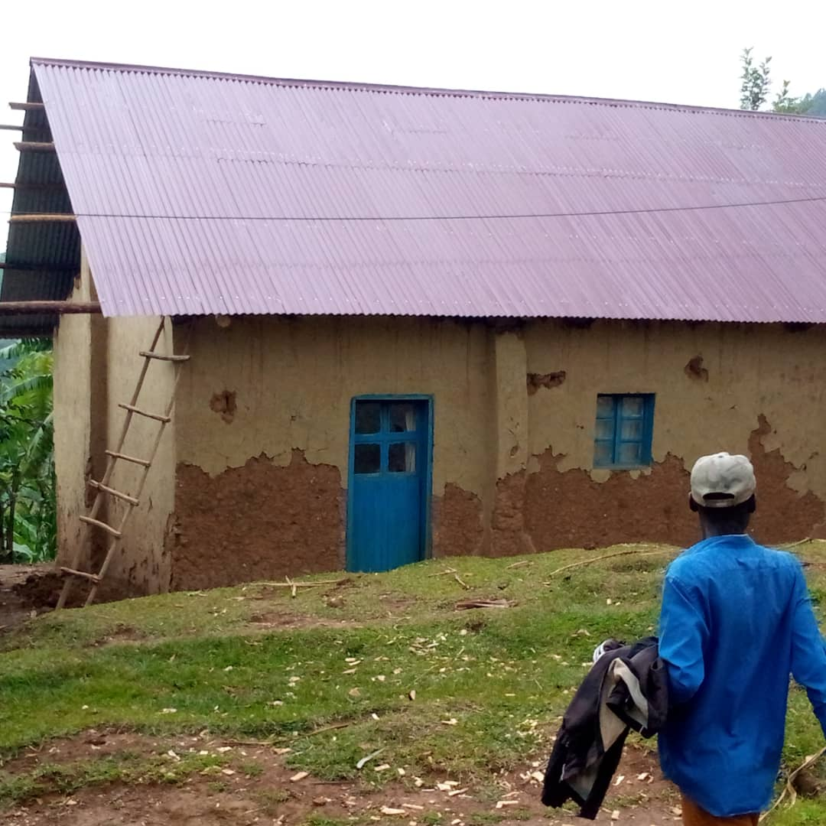
Historical Background of ECCR
ECCR Gitesi Sector,in Karongi District, Western Province.

Slide 19
Way forward
Mushroom cultivation
Mushroom cultivation
The Challenges that we have in the Ministry
Limited budget for renting church buildings and headquarters.
Limited budget of administrative cost for purchasing church equipments, including chairs, computers, sound equipments, Vehicles which will facilitate the staffs during their work,including for the ECCR Moderator when he will need to visit the Chuches.
Limited budget of salaries for office staff and pastors.
Lack of finance for buying a plot of land of 3HA and building the modern ECCR Church and his Head Offices at Gahanga, in KIGALI City.
Lack of funds for reconciliation program between the perpetrators of Genocide who finished their Sentences with the survivors of Genocide.
Lack of funds for social program supporting the poor Christians including shelters, small projects (Like Cultivate Mushroom), clean water, health insurance, school fees of their children etc.

Slide 20
Way forward
Building a Model Temple
Building a Model Temple
The Way forward
ECCR plans to take care of the well being of our pastors, build their family houses, and give them bible trainings as requested by Rwanda government.
ECCR plans to build a modern Church ,schools and hospitals in Rwanda according to the requirements of Rwanda Government.
ECCR plans to establish Radio and Television to spread the Good news of Jesus Christ all over the world.
ECCR plans to establish an international Covenant mountain Prayer in Rwanda.

